Slide 1

Tai Lung RV32I Core
Chris Shakkour
Shahar Dror

Slide 2
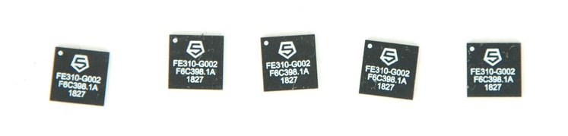

Background
The FE310-G002 includes a SiFive E31 RISC-V core, which is a high-performance single-issue in-order execution pipeline, with a peak sustainable execution rate of one instruction per clock cycle. The RISC-V core supports Machine mode only as well as the standard Multiply, Atomic, and Compressed RISC-V extensions (RV32IMAC).
RV [32, 64, 128] I, M, A, F, D, G, Q, L, C, B, J, T, P, V, N

Slide 3

Road map
RV32I
May-2022
Kick-off
Sep-2021
FPGA
Sep-2022
Privileged Arch
CSR
Jun-2022
Extensions
M+F
Aug-2022

Slide 4


Specs
Spec | Tai Lung | SiFive E31
ISA | RV32I | RV32I-MAC
Arch | 5 stage pipeline | 5-6 variable stages pipeline
Operation frequency | 100 [MHz] | 320 [MHz]
IPC – instruction per cycle | 0.76 (avg) | 1 (avg)
Forwarding mechanisim | Yes | Yes
Branch prediction | No | No
cache | no | 16Kb 2 way Icache
Power | ? | ?
Area | ? | ?

Slide 5
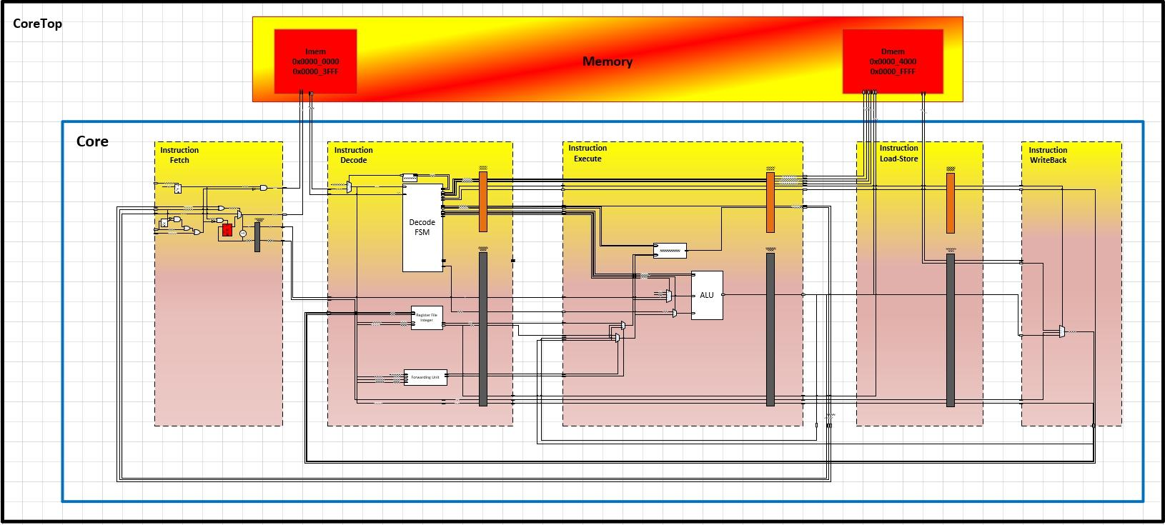
Architecture
RV32I - In order execution - 5 stage pipeline

Slide 6
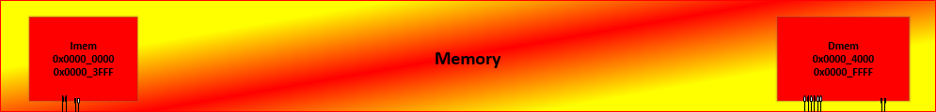
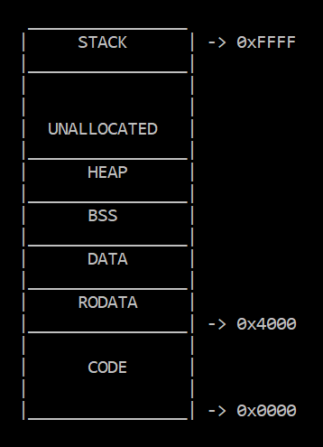
Memory
Memory block | Size | Address Range | Access | Port | Endianness
I-mem | 16Kbytes | 0x0000-0x3FFF | Read only - executable | Single | Little
D-mem | 48Kbytes | 0x4000-0xFFFF | Read/Write – non executable | Single | Little

Slide 7
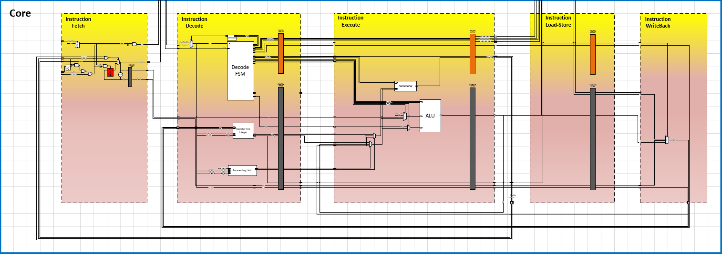
Core

Slide 8
Decode pipeline
Mem
cntrol
Instruction
Branch cntrol
ALU cntrol
The Decode state decoded the 32-bit instruction into the core control signals and change the Core state to execute the instruction.
PC
Write Back
Immediate
RegisterFile data
Forwarded data
PC

Slide 9
Execution pipeline
The Execution state execute the operation based on the instruction, calculate address for Load/Store instructions or decided if a branch operation should be taken.
Branch cntrol
ALU cntrol
Branch resulat
PC
ALU resulat
Immediate
RegisterFile data
Forwarded data
Data hazard control

Slide 10
Execution pipeline
The Execution main component is the Arithmetic Logic Unit (ALU)
which preforms the arithmetic operation for the desired instruction

Slide 11



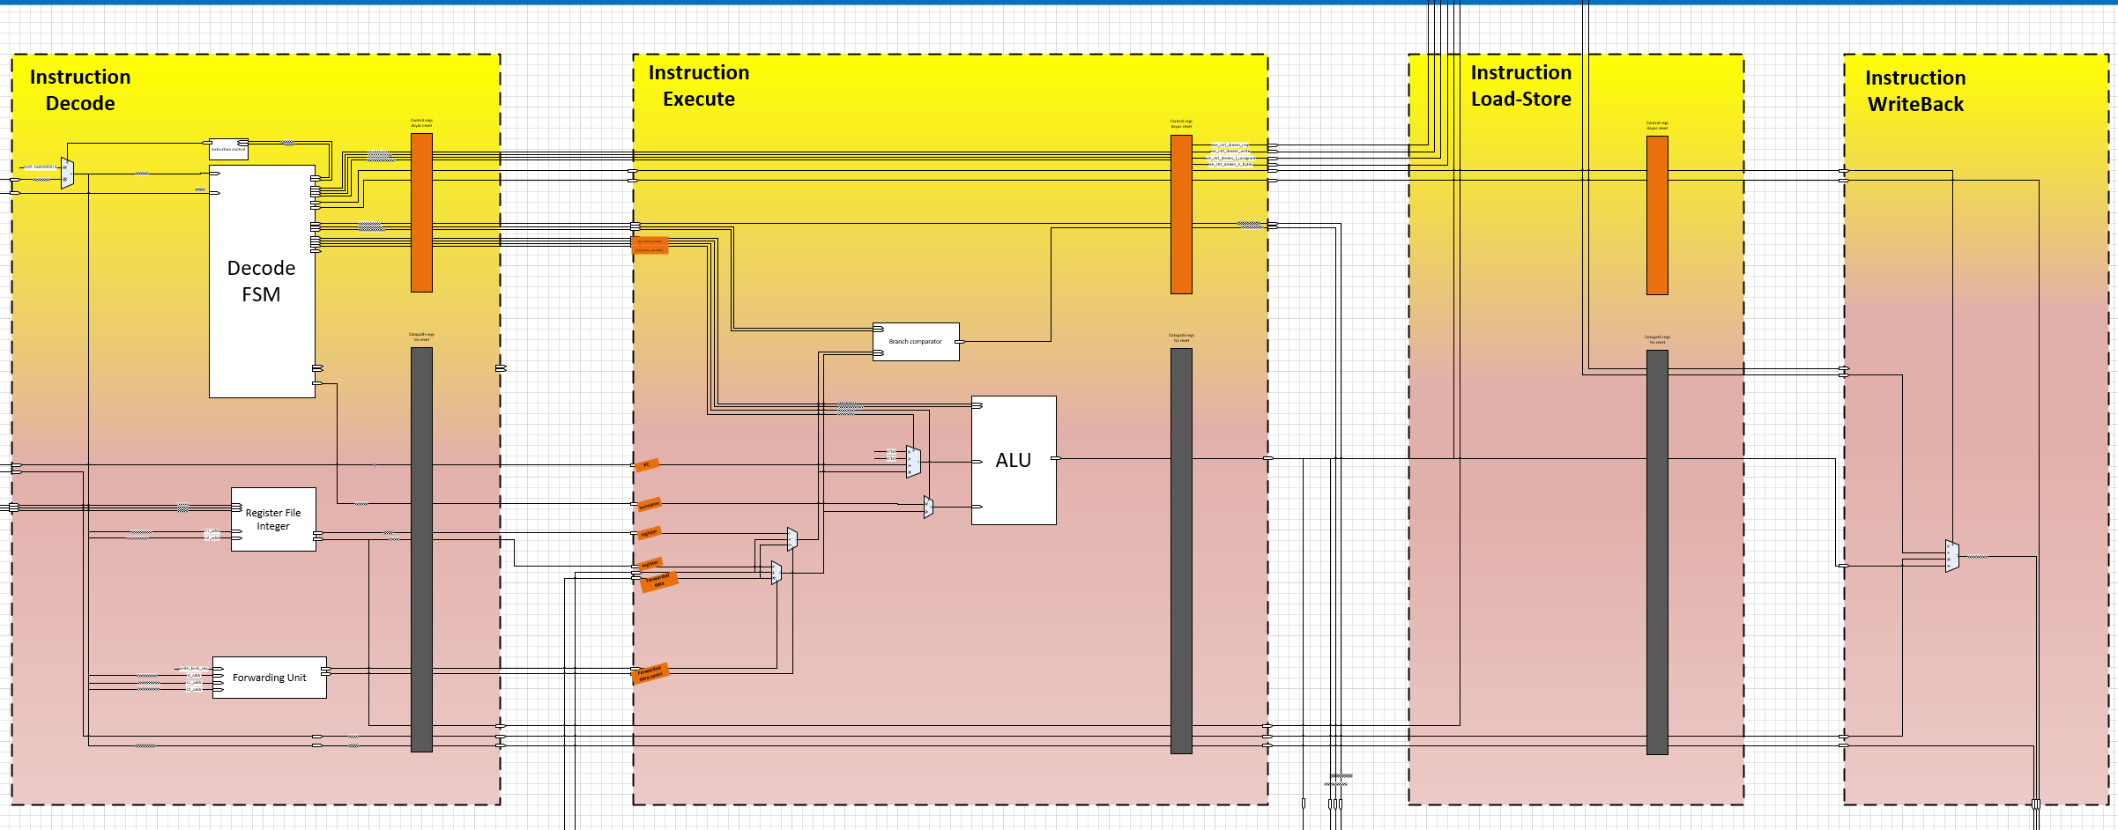
Data hazard
0x0 - addi x1, x0, 5​
0x4 - add x2, x1, x1​
0x8 - add x3, x1, x1​
0xC - NOP​
Data hazard can happen when new instruction need to use a data from a Register before the data is available in the register file

Slide 12
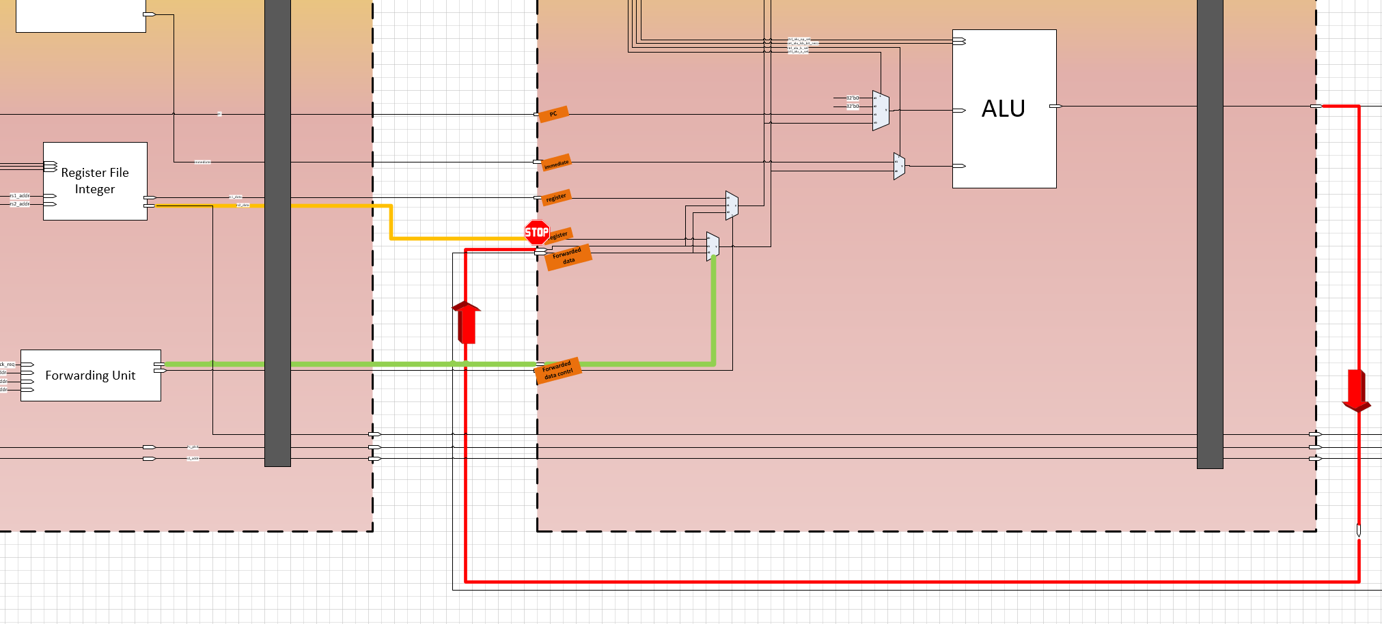
Data hazard – Forwarding unit
Old
x1
x1

Slide 13


Load hazard
0x0 - LW x1, 0(x2)​
0x4 - Add x3, x1,x1​
0x8 - NOP​
0xC - NOP
Load hazard can happen when new instruction need to use a data which loaded from the memory in the previous instruction
x1
Old
x1
Old/irrelevant value

Slide 14
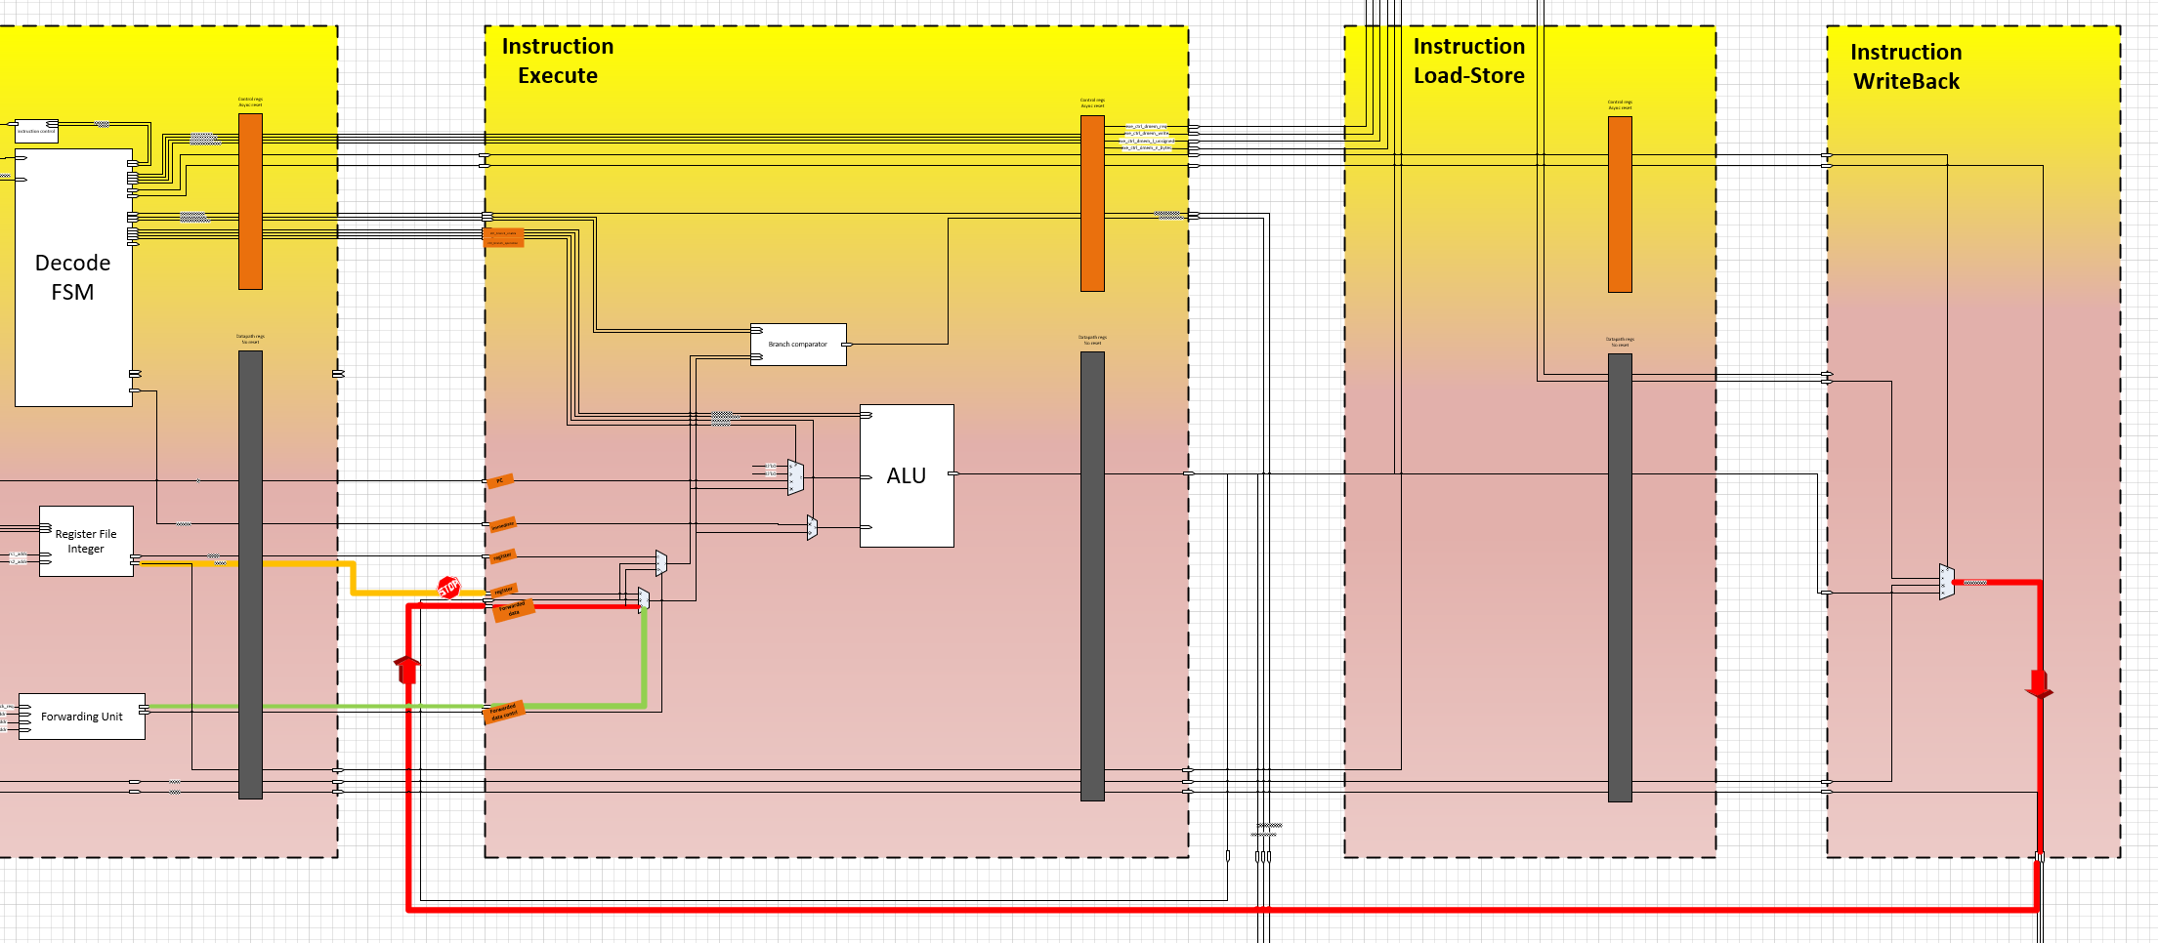
Load hazard
0x0 - LW x1, 0(x2)​
NOP
0x4 - Add x3, x1,x1​
0x8 - NOP​
Load hazard can happen when new instruction need to use a data which loaded from the memory in the previous instruction
0x4 - Add x3, x1,x1​
NOP
0x0 - LW x1, 0(x2)​

Slide 15
Control hazard
0x0 – jump/Branch 0x10​
0x4 - Add x3, x1,x1​
0x8 - Add x4, x10, x10​
0xC - Add x5, x11, x11​
0x10 - Add x6, x12, x12
Load hazard can happen when we have a conditional branch instruction and we don’t know which instruction to fetch
0x4 - Add x3, x1,x1​
NOP
0x0 - LW x1, 0(x2)​

Slide 16
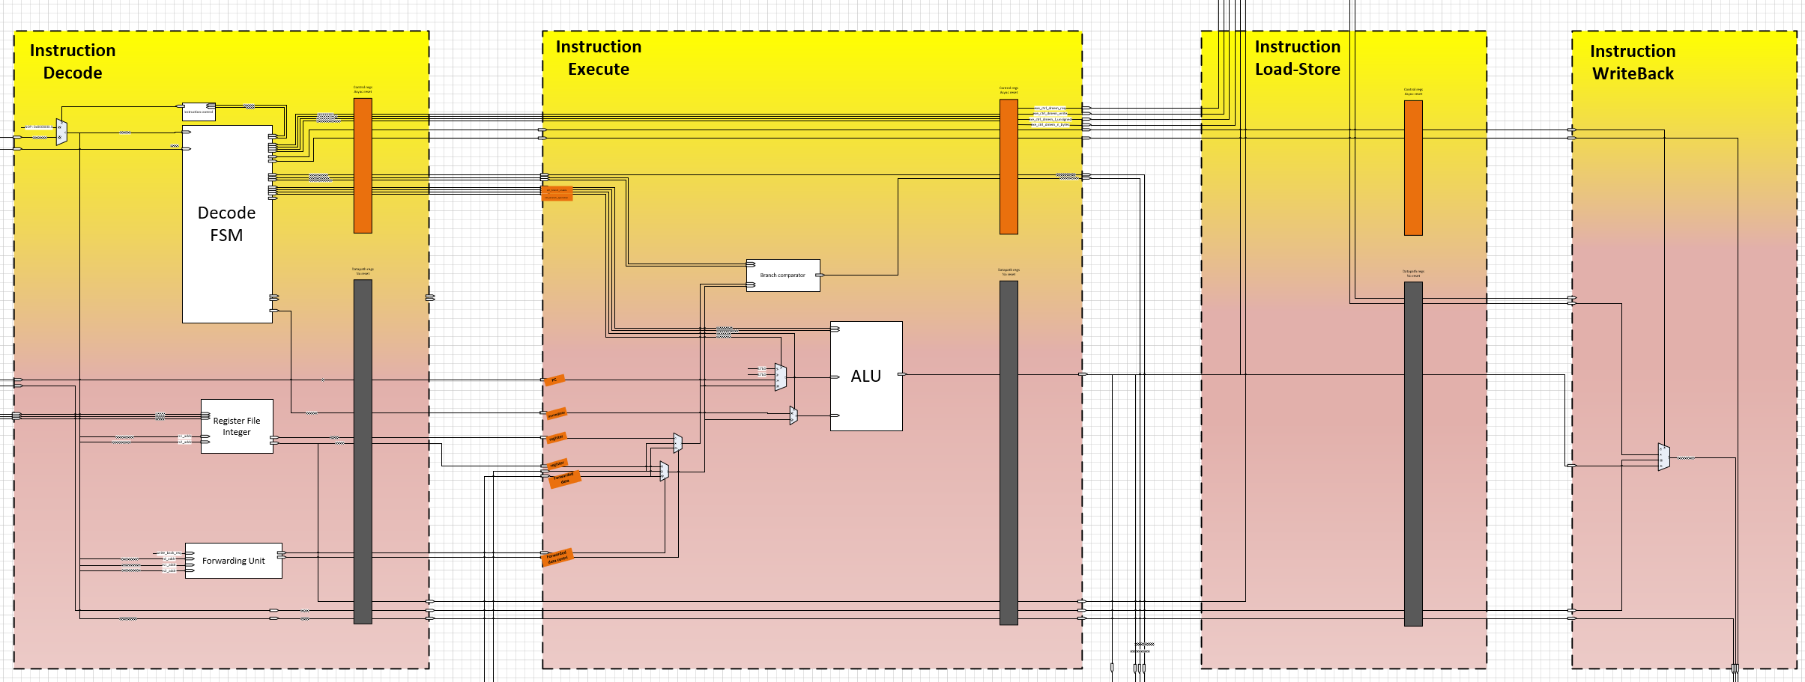
Control hazard
0x0 – jump/Branch 0x10​
0x4 - Add x3, x1,x1​
0x8 - Add x4, x10, x10​
0xC - Add x5, x11, x11​
0x10 - Add x6, x12, x12
0x0 – jump/Branch 0x10​

Slide 17
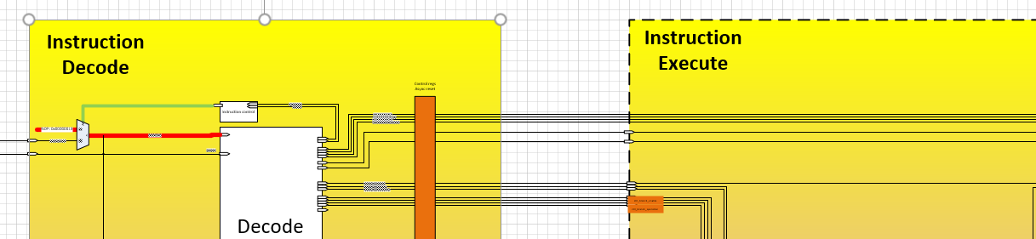
Control hazard
0x0 – jump/Branch 0x10
NOP​
0x4 - Add x3, x1,x1​
0x8 - Add x4, x10, x10​
0xC - Add x5, x11, x11​
0x10 - Add x6, x12, x12
NOP
0x0 – jump/Branch 0x10​
NOP
instruction

Slide 18
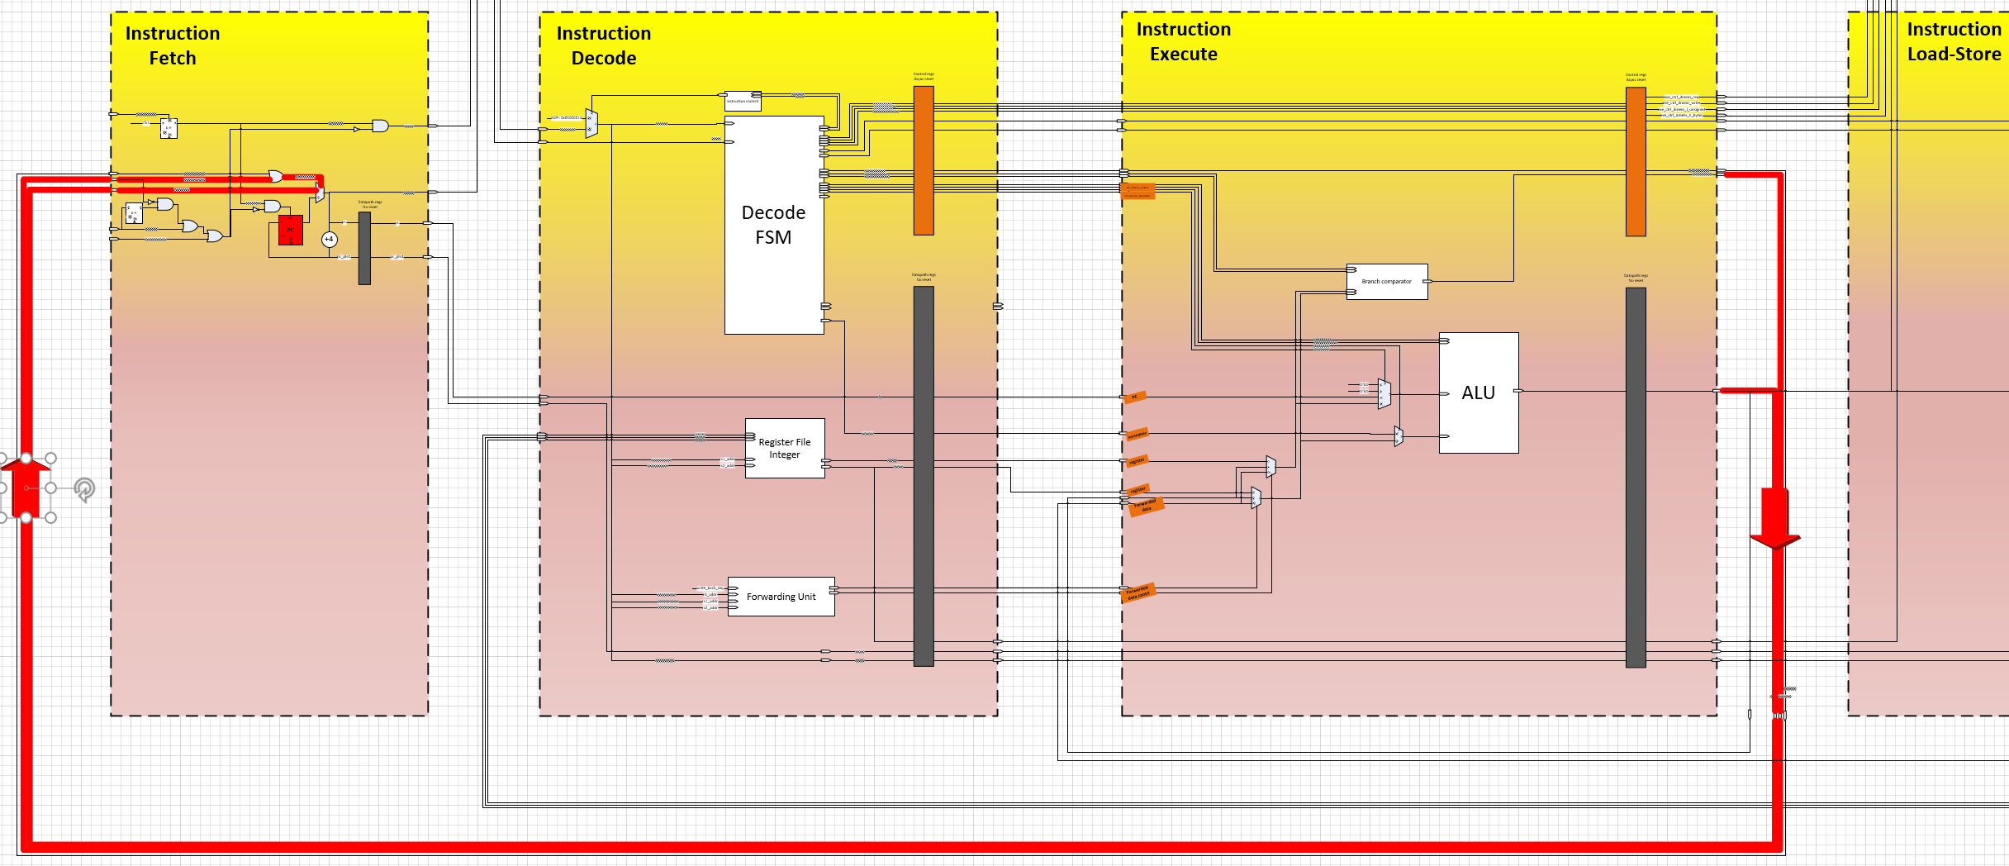
Control hazard
0x0 – jump/Branch 0x10
NOP
NOP​
0x4 - Add x3, x1,x1​
0x8 - Add x4, x10, x10​
0xC - Add x5, x11, x11​
0x10 - Add x6, x12, x12
NOP
NOP
0x0 – jump/Branch 0x10​
Next Instruction

Slide 19
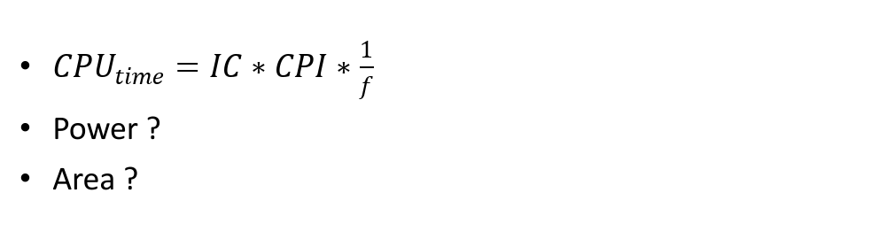
Performance
$CPU_{time}=IC∗CPI∗\frac{1}{f}$
Power ?
Area ?
Test | Instructions retired | Cycles | IPC | Description
Tower of Hanoi | 28198 | 37924 | 0.743 | N of disks = 10
Sudoku solver | 3533 | 4909 | 0.720 | Cube = 9x9
Fibonacci | 470725 | 645863 | 0.728 | Fib(20)
Binary search | 652 | 751 | 0.868 | N=200 elements

Slide 20

Validation plan
ISA simulations
Design review
Data memory image comparison
RTL simulations
System-level simulation
Validation trackers
FPGA deployment
Performance trackers

Slide 21

Demo

Slide 22





Alternatives… RISC based Arch
Apple-IBM-Motorolla
Analog Devices
2000
Atmell arduino
Acorn RISC machines
1978
1981-Stanford
Playstation-2
Wave computing

Slide 23

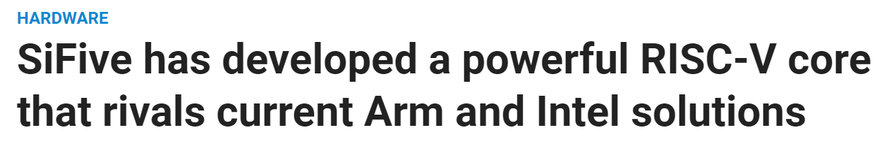
RISC-V in the press

